Slide 1
CMPUT 206: Image Compression Basics
Nilanjan Ray
Computing Science

Slide 2
Agenda
We will look at the following basic concepts in signal compression:
Compression measures
Entropy
DPCM (Differential pulse code modulation)
Lossless coding example - Huffman coding
In the second half, we will talk about coding images
JPEG image compression

Slide 3
Measure of compression
Bits per pixel (BPP) is the average number of bits required to store a pixel in an image
In an uncompressed image, BPP = log₂ (K) = B, where K is the number of gray levels; ex. K = 256, BPP = log₂ (256) = 8 (this is the reason a 256 graylevel image is also called a 8-bit image)
Compression ratio is defined as B / BPP
Example: after compressing a 8-bit, 200-by-300 image with JPEG, the total image size has become 150,000. So the BPP is 150000/ (200*300) = 2.5; Thus, CR = 8 / 2.5 = 3.2

Slide 4
Lossless coding
After compression an image or a signal does not lose any information, meaning the image or the signal can be obtained (aka reconstructed) exactly
Example: winzip of files
Lossless coding usually does not achieve a high compression ratio, because it does not throw away any information; for images and signals, lossy and lossless compressions are used in conjunction, such as JPEG standard.

Slide 5
How is an image or a signal compressed?
Compression is an attempt to reduce the redundancy or correlation between the pixels
Most images are highly redundant; neighboring pixels have very high correlation
Homogeneous areas in an image have very similar pixel values
Across edges, similar difference of pixel values exist
In textured areas, similar patterns repeat (periodicity, symmetry, etc.)

Slide 6
Idea behind lossless coding
Variable word lengths to use for coding pixel values
Assign short word lengths to pixel values that occur frequently
Assign longer word lengths to pixel values that occur not so frequently
With this strategy, on an average BPP is reduced

Slide 7
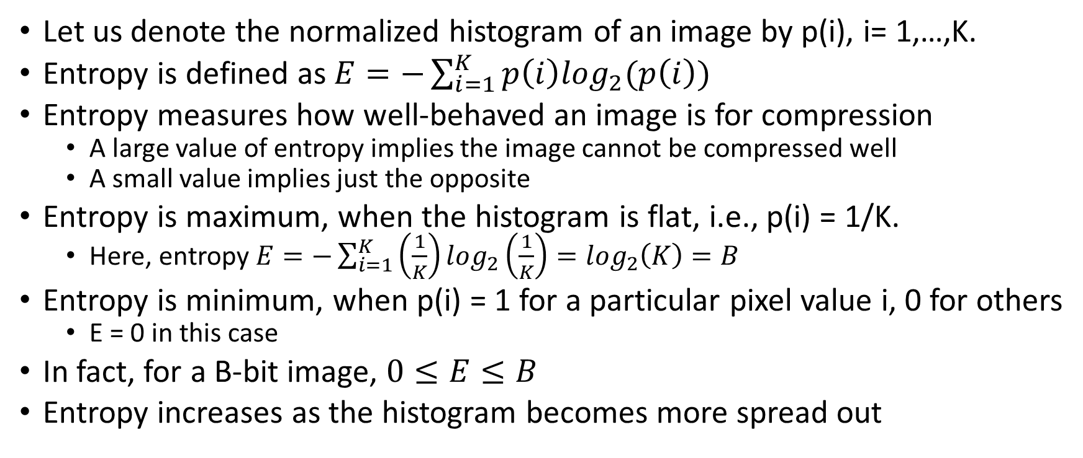
Entropy
Let us denote the normalized histogram of an image by p(i), i= 1,…,K.
Entropy is defined as $E=−\sum_{i=1}^{K}{p\left(i\right)\log_{2}(p\left(i\right))}$
Entropy measures how well-behaved an image is for compression
A large value of entropy implies the image cannot be compressed well
A small value implies just the opposite
Entropy is maximum, when the histogram is flat, i.e., p(i) = 1/K.
Here, entropy $E=−\sum_{i=1}^{K}{\left(\frac{1}{K}\right)\log_{2}\left(\frac{1}{K}\right)}=\log_{2}\left(K\right)=B$
Entropy is minimum, when p(i) = 1 for a particular pixel value i, 0 for others
E = 0 in this case
In fact, for a B-bit image, $0≤E≤B$
Entropy increases as the histogram becomes more spread out

Slide 8

Significance of entropy
There is an important theorem in information theory: $BPP≥E$
The interpretation is that with a lossless coding the best BPP you can achieve is the entropy for the image

Slide 9
DPCM for entropy reduction
We have seen that entropy is the best that can be achieved as BPP by a lossless compression
So, why not try to reduce the entropy by some means
DPCM (Differential pulse code modulation) is a way to achieve lower entropy
DPCM tries to reduce the spread of a histogram in a lossless manner

Slide 10
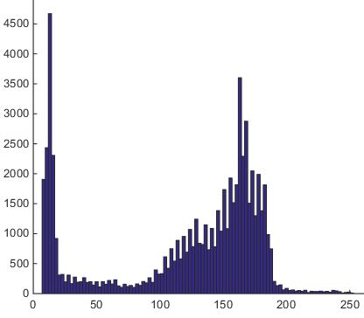
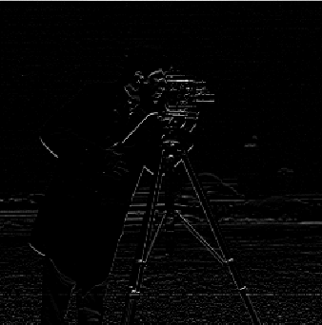
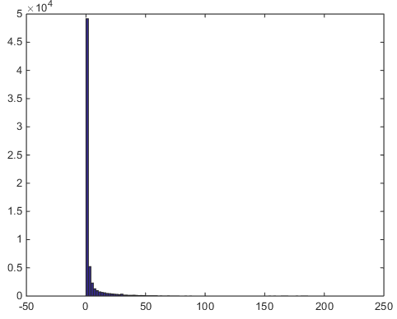
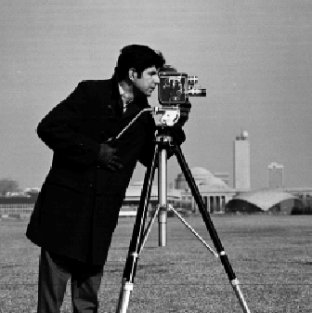
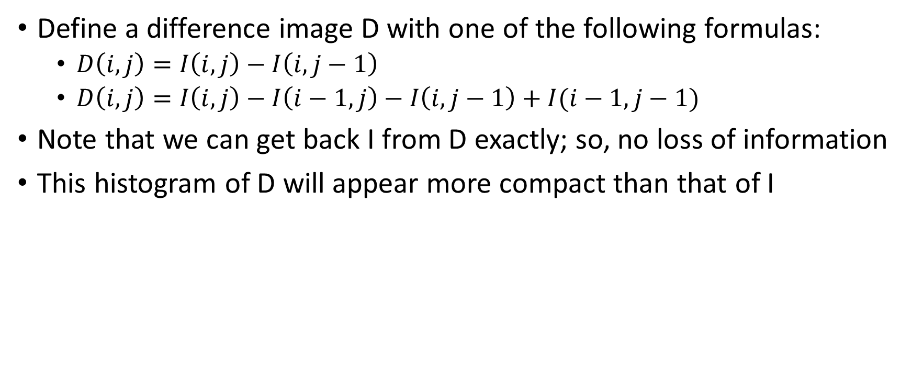
Simple DPCM
Define a difference image D with one of the following formulas:
$D\left(i,j\right)=I\left(i,j\right)−I\left(i,j−1\right)$
$D\left(i,j\right)=I\left(i,j\right)−I\left(i−1,j\right)−I\left(i,j−1\right)+I(i−1,j−1)$
Note that we can get back I from D exactly; so, no loss of information
This histogram of D will appear more compact than that of I
Image I
Difference Image D

Slide 11
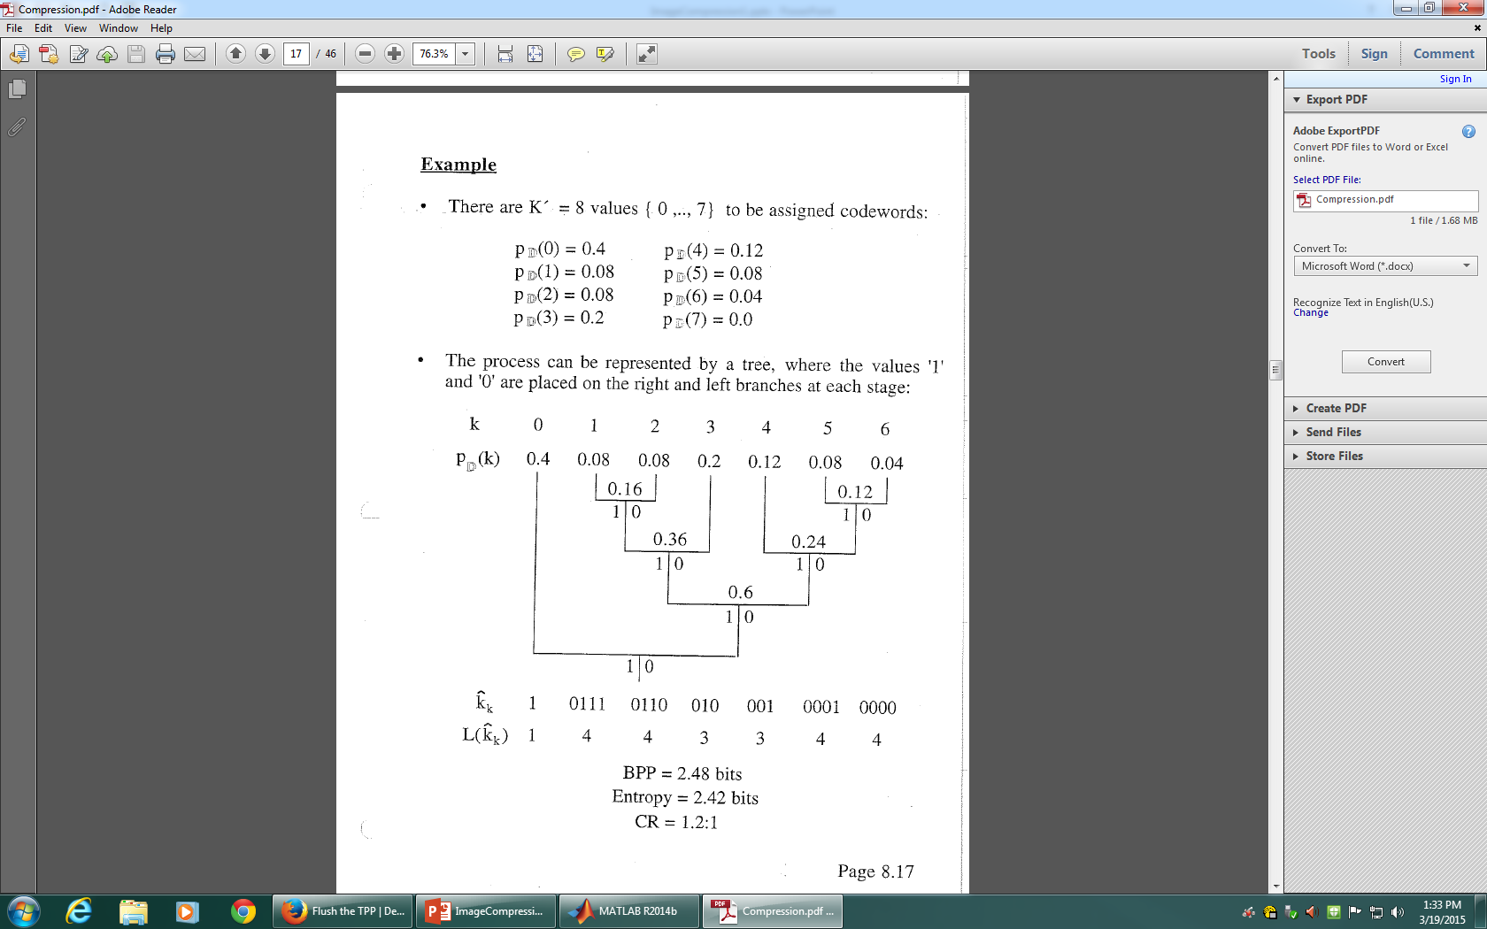

Lossless coding: Huffman code
Once the entropy is reduced by say DPCM, apply Huffman coding to the difference image D

Slide 12
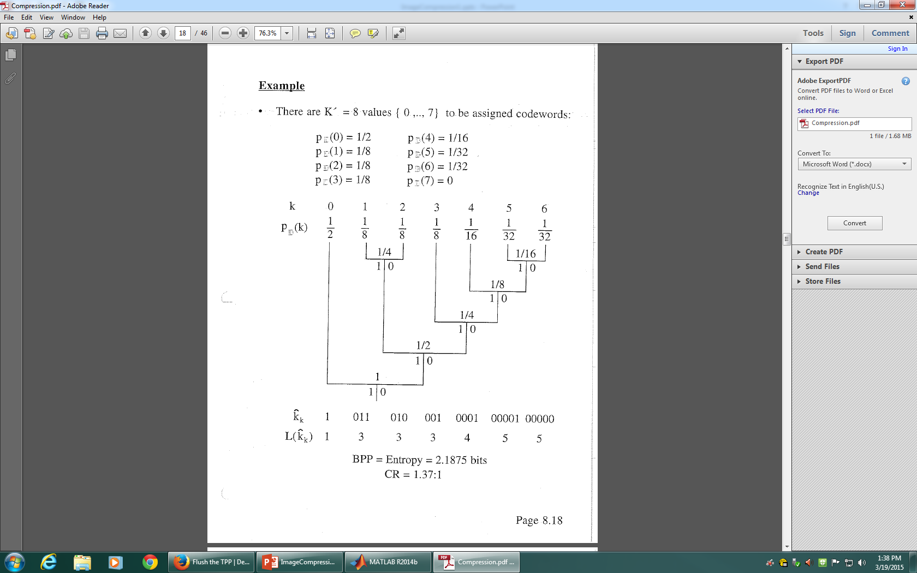
Huffman coding: another example

Slide 13
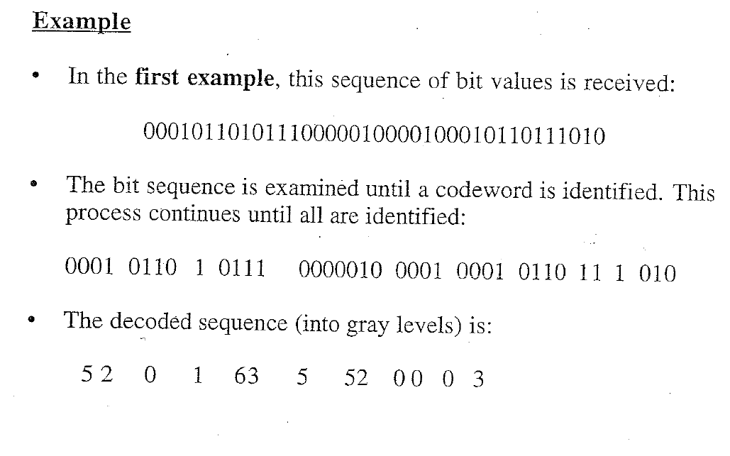
Huffman code: decoding
Decoding takes place by traversing the tree once a bitstream is received

